Slide 1

Capstone Project : Predicting Customer Churn in Telecom
Telco Churn Retention Targeting
Mentee: Olatunde Samson Adekunle _ (DSML) FE/23/20528373
Mentor: Olatunji Bilikisu
Date: January 2026
1

Slide 2
Problem Statement
Customer churn is a critical issue in telecom.
Rising churn → loss of market share → revenue decline.
Telecoms lose 15-25% customers annually, costing millions in acquisition (5-10x retention cost).
Example : GLO had a reduction in market share churn with dip in market share decline from 26% → 20% decline in market share , 9mobile from 15 % - 3 %
Predicting Customer retention targeting is key
Notes:
[
Script]
In five minutes I will show: (1) how we engineered features safely, (2) how we trained models, (3) how we evaluated using Lift@k, (4) how we selected a champion using min–max weighted scoring, and (5) what the Streamlit app delivers operationally.
[Sources]
- Internal project file: model_comparison_results.csv

Slide 3
Predicting Customer Churn in Telecom
Predicting Customer Churn in Telecom -> Churn Retention Targeting
Baseline churn ≈ 26.5%
Best Lift@10% ≈ 2.89×
Champion (weighted): LR (bal)
Challenger: HGB
What this project delivers
Builds a Predictive model that assigns each customer a churn probability (a “risk score”).
A Streamlit app that ranks customers and produces Top 10% / Top 20% ,Prioritize retention for high-value users; enable proactive campaigns. outreach lists.
Clear metrics: Baseline, Precision@k, Recall@k, Lift@k, plus a weighted model score for selection.
Notes:
[
Script]
In five minutes I will show: (1) how we engineered features safely, (2) how we trained models, (3) how we evaluated using Lift@k, (4) how we selected a champion using min–max weighted scoring, and (5) what the Streamlit app delivers operationally.
[Sources]
- Internal project file: model_comparison_results.csv

Slide 4
Overview
About the models
Model outputs
The models does:
label customers as “churn” or “no churn
assigns each customer a churn probability (risk score)
The models, Logistic Regression, Random Forest, HistGradientBoosting, each produces a churn probability (risk score)
Output: a number between 0 and 1 for each customer
Our understanding:
How likely this customer is to churn
We use the scores to rank customers and target the Top 10% or 20% for retention outreach (apply a threshold only when we need a hard yes/no decision).
proba = model.predict_proba(X)[:, 1]
Notes:
[
Script]
In five minutes I will show: (1) how we engineered features safely, (2) how we trained models, (3) how we evaluated using Lift@k, (4) how we selected a champion using min–max weighted scoring, and (5) what the Streamlit app delivers operationally.
[Sources]
- Internal project file: model_comparison_results.csv

Slide 5
Predicting Customer Churn in Telecom
Predicting Customer Churn in Telecom -> Churn Retention Targeting
Methodology
Dataset
data/processed/
telco_churn_processed.csv
(or uploaded CSV)
Telco dataset from Kaggle (7k rows, 21 features: tenure, monthly charges, services).
Model
joblib load
logistic_regression.pkl
hist_gradient_boosting.pkl
Streamlit app
Align schema → score
Compute Lift@k
Export targeting list
Notes:
[
Script]
In five minutes I will show: (1) how we engineered features safely, (2) how we trained models, (3) how we evaluated using Lift@k, (4) how we selected a champion using min–max weighted scoring, and (5) what the Streamlit app delivers operationally.
[Sources]
- Internal project file: model_comparison_results.csv

Slide 6
1) Feature engineering
2) Model training (simple models, strong ranking)
3) Model evaluation: Lift@k is the targeting KPI
Goal: give the model clean, consistent inputs without leaking the answer
Lift@k answers: “Is Top 10% / Top 20% targeting better than random selection?”
Train multiple candidates; keep the process reproducible
• Baseline churn rate: average churn in the evaluation set
• Precision@k: churn rate inside the Top k% targeted list
• Lift@k = Precision@k ÷ Baseline (how many times better than random)
• Recall@k: % of all churners captured in the Top k% list
Data quality & outliers
What we trained
Logistic Regression (standard) and Logistic Regression (class_weight=balanced).
Random Forest (standard) and Random Forest (balanced).
HistGradientBoosting for non-linear ranking improvements.
Convert TotalCharges to numeric and handle blanks → avoid NaNs during training.
Use robust ratios (e.g., charges_ratio = TotalCharges / (tenure + 1)) to avoid divide-by-zero related errors.
One-hot encode categories; missing dummy columns are treated as 0 at scoring time.
How we split
Use a stratified holdout split so churn/non-churn proportions are preserved.
Train on train split; report Lift@k on held-out test split.
Save models to disk for the Streamlit app to load (joblib)
If baseline = 0.265 and Precision@10% = 0.773,
Lift@10% = 0.773 / 0.265 ≈ 2.91×.
Meaning: Top 10% is ~3× more churn-heavy than average
Leakage controls
Never use the churn label (Churn_Yes) as an input feature.
Quantile-based flags (e.g., “HighSpender”) should be fit on TRAIN only, then applied everywhere.
Keep the model’s feature list as the contract (feature_names_in_) and align inputs exactly.
Why this matters
Lift curve behavior (expected)
Use a stratified holdout split so churn/non-churn proportions are preserved.
Train on train split; report Lift@k on held-out test split.
Save models to disk for the Streamlit app to load (joblib).
Lift is highest at very small k (top 1–5%) and decreases as we target more customers.
This is normal because we include more lower-risk customers as k grows.
Notes:
[
Script]
Feature engineering is where most churn projects accidentally “cheat”. If we accidentally include the label or compute thresholds on the full dataset, evaluation looks better than reality. We fix TotalCharges NaNs, use safe ratios, and treat the trained feature list as the contract.
[Sources]
- Internal project file: feature_engineering.py

Slide 7
Solution /Implementation
4) Weighted model scoring: why min–max normalization
We need one score that reflects business priorities across multiple metrics.
Problem: metrics are on different numeric scales
• Lift@10% and Lift@20% are multipliers (~2–3× here)
• PR-AUC is between 0 and 1
• If we add raw numbers, one metric can dominate unfairly
Solution: normalize each metric to 0–1 and apply weights
Min–max normalization
Weighted score
norm(x) = (x − min) / (max − min)
0 = worst model on that metric, 1 = best model on that metric.
Score = 0.60·norm(Lift@10%) + 0.30·norm(Lift@20%) + 0.10·norm(PR-AUC)
Lift@10% (60%)
Lift@20% (30%)
PR-AUC (10%)

Slide 8
4) Weighted model scoring: why min–max normalization
Lift@k tells us how much better we are than random selection
Model | weighted_score | lift@10% | lift@20% | pr_auc
logistic_regression_balanced | 0.850000 | 2.858934 | 2.565024 | 0.654469
hist_gradient_boosting | 0.715092 | 2.885653 | 2.444789 | 0.640127
logistic_regression | 0.663915 | 2.832215 | 2.551665 | 0.652185
Notes:
[
Script]
We train several model families. The main point is not complexity; it is reliable ranking at the top of the list. We use a stratified holdout and report top‑k metrics because that matches how retention teams operate.
[Sources]
- Internal project file: model_comparison_results.csv

Slide 9
4) Challenger decision
Decision uses weighted score with min–max normalization.
Champion (Production default)
Weighted score formula
Logistic Regression (balanced)
Why: best overall weighted score (strong Lift@20% + strong PR-AUC + high Lift@10%).
Best all-round choice for Top 10% and Top 20% targeting.
norm(x) = (x − min) / (max − min)
Score = 0.60·norm(Lift@10%) + 0.30·norm(Lift@20%) + 0.10·norm(PR-AUC)
Challenger (Pilot comparison)
We convert each metric to a fair 0–1 grade, then add them using the business weights.
HistGradientBoosting
Why: best Lift@10% (“Top 10% sniper”).
Test head-to-head vs Champion in pilot for incremental ROI.

Slide 10
5) Deployment & readiness (app + pilot)
Turn scores into action, then prove ROI with a controlled pilot
Streamlit app components
Pilot & monitoring (5 bullet plan)
Controls: model choice, Top 10%/20%, minimum threshold, holdout metrics toggle.
Scoring: align input features to the model’s expected schema and compute probabilities.
Outputs: prioritized table + CSV export for operations.
Metrics: fixed churn label (Churn_Yes) to prevent invalid evaluation.
Pilot: randomize within Top 10% into Treatment vs Control.
Measure: churn uplift + ROI after offer and outreach cost.
Calibration: make probabilities reliable for threshold-based policies.
Drift monitoring: feature drift + score drift + Lift@k stability.
Decision: scale champion; keep challenger for periodic re-tests.
Notes:
[
Script]
The app is the operational layer: it turns a trained model into a weekly action list. The next step is not more modeling; it is a controlled pilot to quantify ROI, plus basic monitoring to ensure performance does not drift.
[Sources]
- Internal project file: app_retention_targeting_v2_clean.py

Slide 11
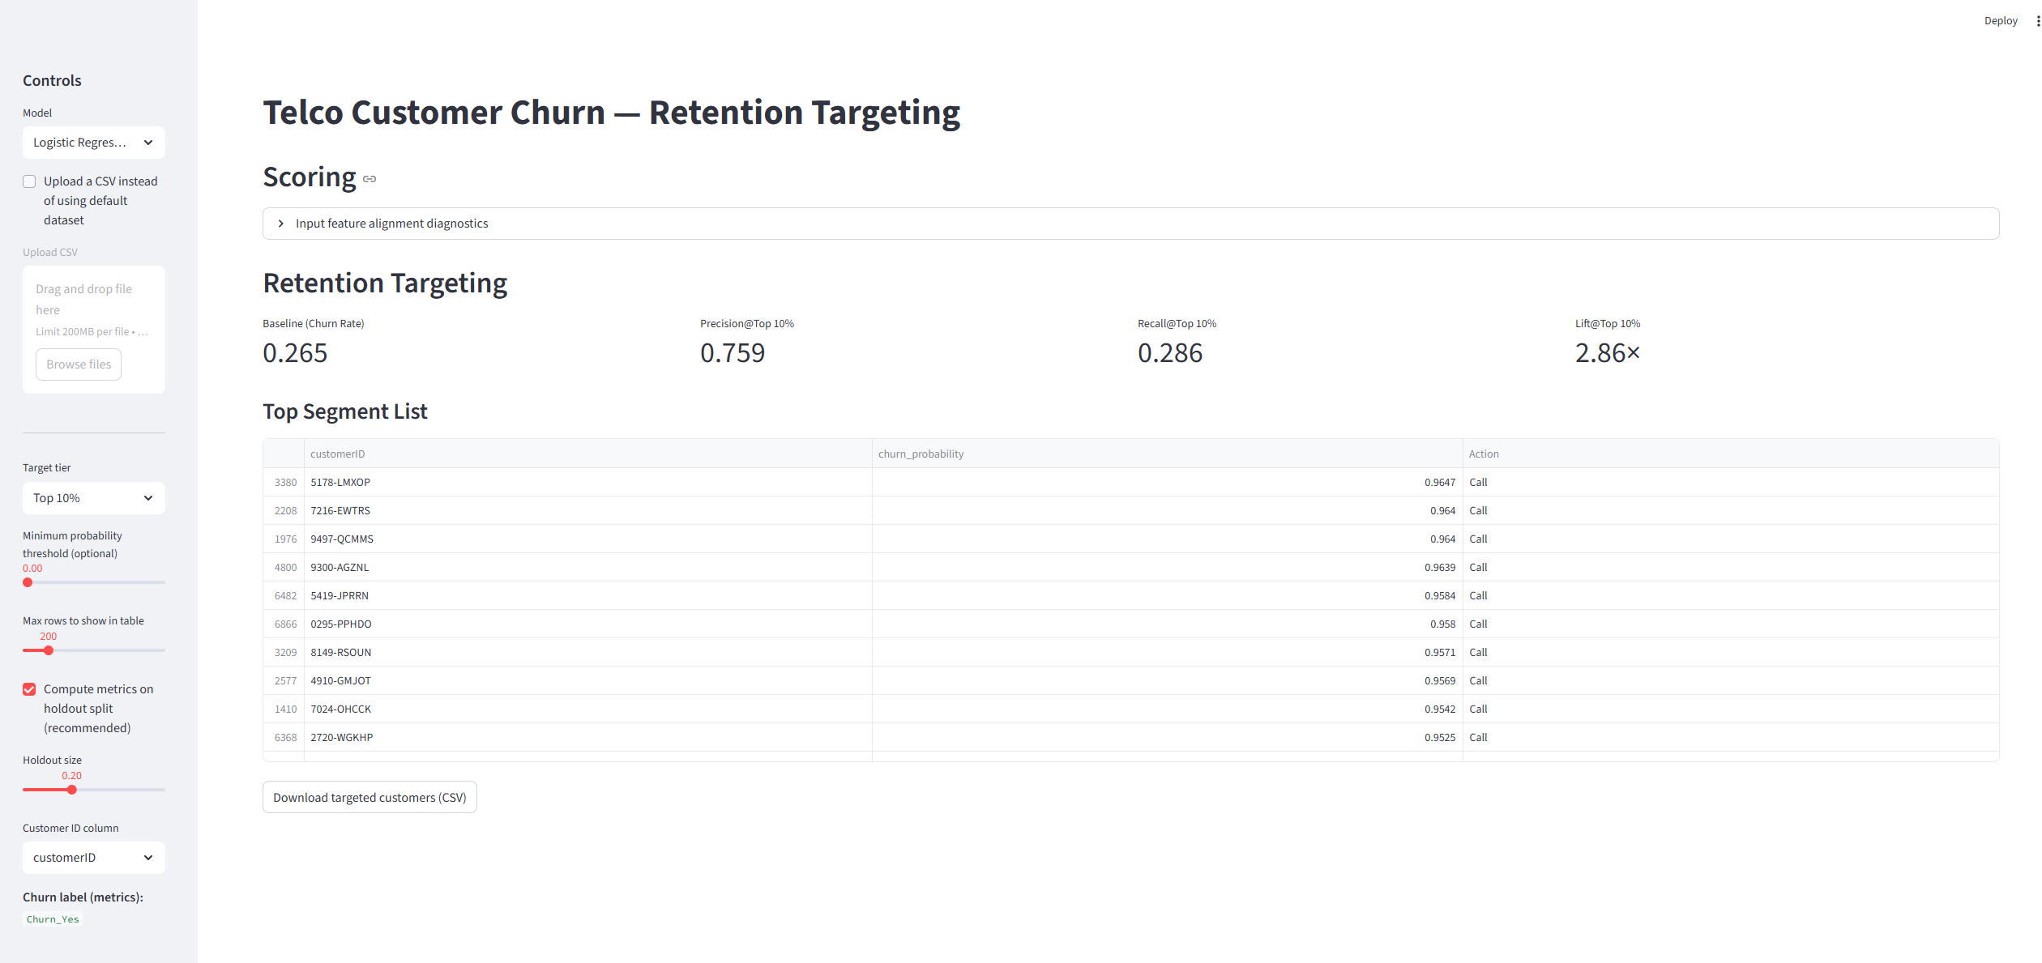
Streamlit App
Notes:
[
Script]
In five minutes I will show: (1) how we engineered features safely, (2) how we trained models, (3) how we evaluated using Lift@k, (4) how we selected a champion using min–max weighted scoring, and (5) what the Streamlit app delivers operationally.
[Sources]
- Internal project file: model_comparison_results.csv

